Slide 1


J.B.institute of engineering & technology
Project name : smart trolley & billing

Slide 2
Contents :
Problem Statement
Idea/Approach Details
Introduction
Tools /Equipments Required
Existing System
Proposed System
Visualization
Sustainability
impacts
Reference

Slide 3
Problem statement :
(SIH1475)-Student Innovation (Robotics And Drones – There is a need to design robots that can solve some of the pressing challenges of India such as smart shopping , handling medical emergencies , search and rescue operations , etc…)

Slide 4
IDEA/APPROACH DETAILS :
The main idea of the model is to give customer a smart shopping experience by providing smart trolley and billing.
Day by day technology is getting improved and we suggest smart trolley and billing approach that sellers can afford.
Another thing is save time and save labour at billing counter.

Slide 5
INTRODUCTION :
We waste a lot of time in standing in queue while billing in a super market , also we inspired by covid – 19 period and we came up with this approach for social distancing in super market . We delved deeper in the topic and brought up a smart trolley and smart billing for customers in order to save the time and energy.

Slide 6
TOOLS/EQUIPMENTS REQUIRED : hardware tools :
1. Arduino UNO R3 2. Motor Driver Shield
3. BO Motors 4.Servo Motor
5. Wheels 6.Ultrasonic Sensor
7. Sensor Stand 8. Batteries
9. Sunboard 10. Male and Female Jumper Wires
11. Battery Holder 12.Switch
13.Ultrasonic Sensor based obstacle avoiding robot
SOFTWARE TOOLS :
1.Microsoft power apps

Slide 7
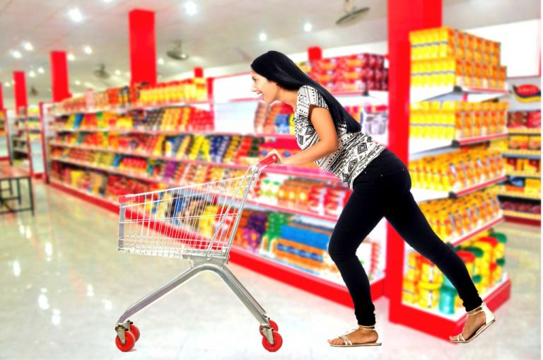

EXISTING SYSTEM :
PRESENT TROLLEY SYSTEM :
The customer has to pull the trolley
by themself.
PRESENT BILLING SYSTEM :
The billing process is quite tedious and
highly time consuming . It also require
more employees at the billing counter.

Slide 8
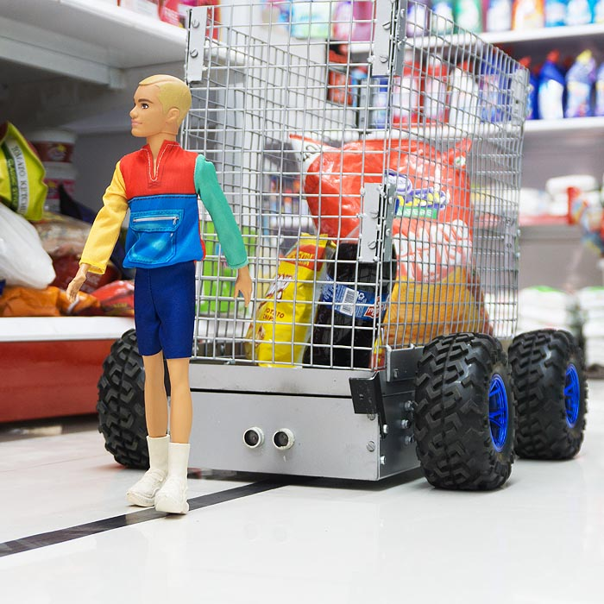
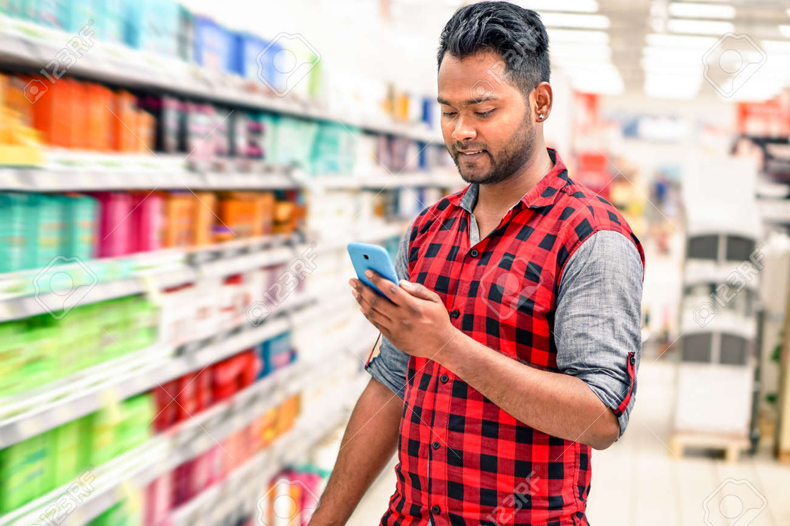
PROPOSED SYSTEM :
ADVANCED TROLLEY SYSTEM :
Here ,the trolley will follow the
customer’s path . And it saves the
energy of the customer.
ADVANCED BILLING SYSTEM :
The billing process is quite easy
and it consumes less time .It does
not require more employees.

Slide 9
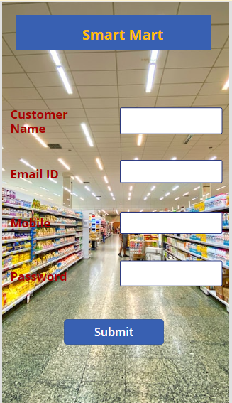
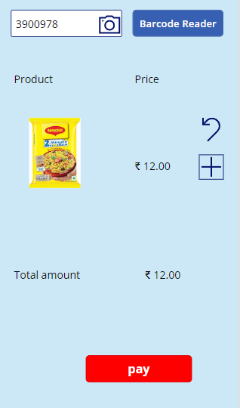
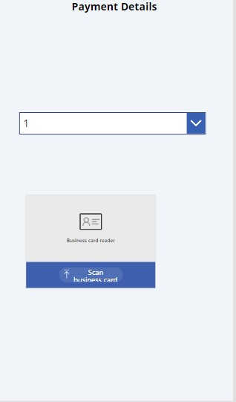
VISUALIZATION :
Initially we need to register into the app by After all the formalities the app will show the id of a trolly which is available.
The path is already given to the trolley so that we can connect the trolley to our mobile via Bluetooth and we can direct trolley to move in certain directions.
The customer need to open the app and scan/enter the bar code and there will be add and remove button so that the customer add and remove the products.
Trolley also have a LED display so the amount and transaction status will displayed
After shopping when the user exits the app then the trolley will automatically disattach from the user and available for next user

Slide 10
Sustainability :
The cost of implementing smart trolleys can be sustainability factor.
The sustainability impact also depends on how readily customers adopt and utilize smart trolley.
One of the most direct ways smart billing supports sustainability is reducing the need for paper invoices
Smart billing systems can improve accuracy, which can reduce the no billing errors and the need for reissued invoices.
Encouraging electronic payment through smart billing can reduce the use of cheques and envelops, which are often made from paper an can contribute to waste.

Slide 11
iMPACTS :
Smart trolley can provide a more convenient and efficient shopping experience
Smart billing can save shoppers time and energy by automating certain tasks like avoid standing in queue etc...
Smart trolleys can be designed to be more accessible for people with disabilities making shopping more inclusively.
Smart billing can reduce adiministrative costs associated with manual billing processes, such as printing and mailing invoices
Smart billing can accelerate payment collection since invocies can be delivered electronically and customers can make payment online.

Slide 12
References :
https://www.youtube.com/watch?v=yAV5aZ0unag
https://powerapps.microsoft.com/en-in/
https://www.youtube.com/watch?v=2RzCbd5XgJg

Slide 13
Team members details :
Team Leader Name : Emmadi Divya
Team Member-1 Name : Janolla Navanitha
Team Member-2 Name : Ponnala Deekshitha
Team Member-3 Name : Vujjini Deekshitha
Team Member-4 Name : Wazib Rehaman Shaik
Team Member-5 Name : Kodati Vamshi Krishna
Team Mentor Name : Shruti Soma ( Expertise : AI/DS/ML)
DEPARTMENT : ARTIFICIAL INTELLIGENCE AND DATA SCIENCE
YEAR : B-TECH III rd YEAR

Slide 14


Slide 15


